Slide 1
Wifi Hacking
Hacking wifi for fun and profit
Neko

Slide 2
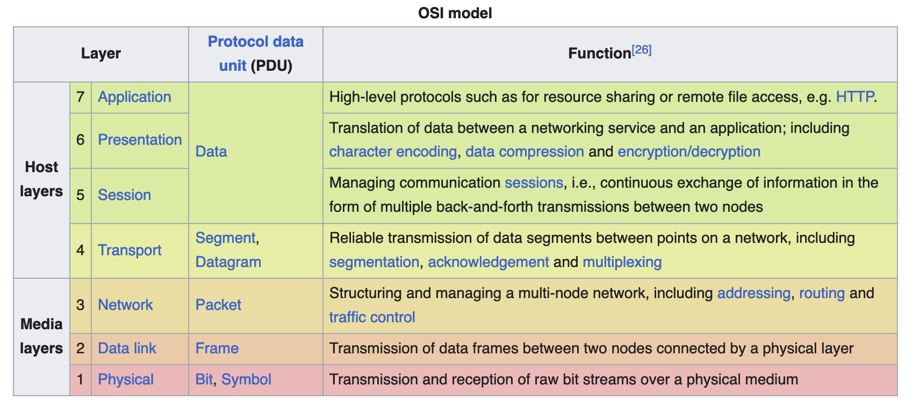
Abstraction
Layers

Slide 3
Interpretation
Developer
Standards
Implementation

Slide 4
What is it?
https://ieeexplore.ieee.org/browse/standards/get-program/page/series?id=68

Slide 5
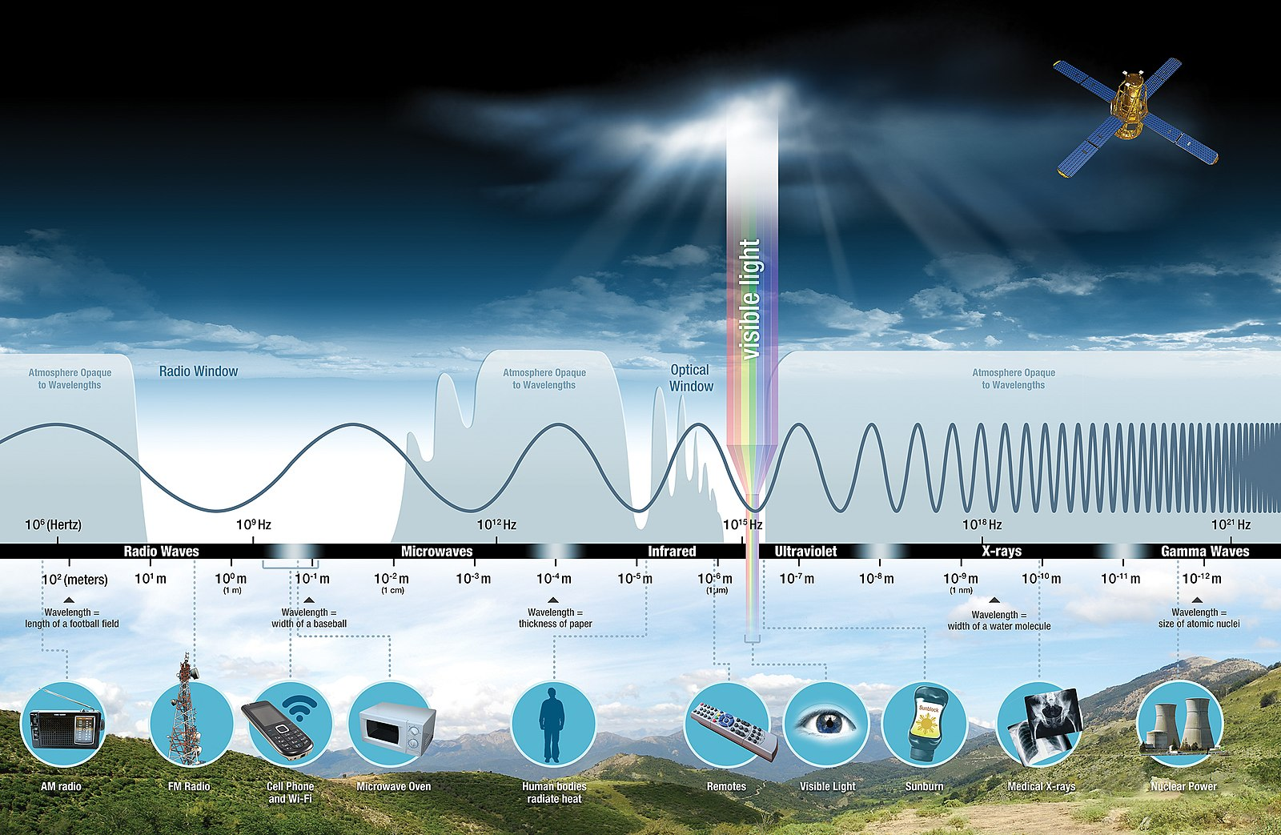
Radiation
Wifi
900 MHz
2.4 GHz
5 GHz
6 GHz

Slide 6
802.11/Wifi Generations
802.11 -> Wifi 0: 1997
802.11b -> Wifi 1: 1999
802.11a -> Wifi 2: 1999
802.11g -> Wifi 3: 2003
802.11n -> Wifi 4: 2009
802.11ac -> Wifi 5: 2013
802.11ax -> Wifi 6 (E for Extended!): 2019
802.11be -> Wifi 7: 2024
802.11bn -> Wifi 8: Unreleased

Slide 7
Some Radio Stuffs
CSMA/CA
Multiplexing
FDM
OFDM
Multipath Propagation
MIMO

Slide 8
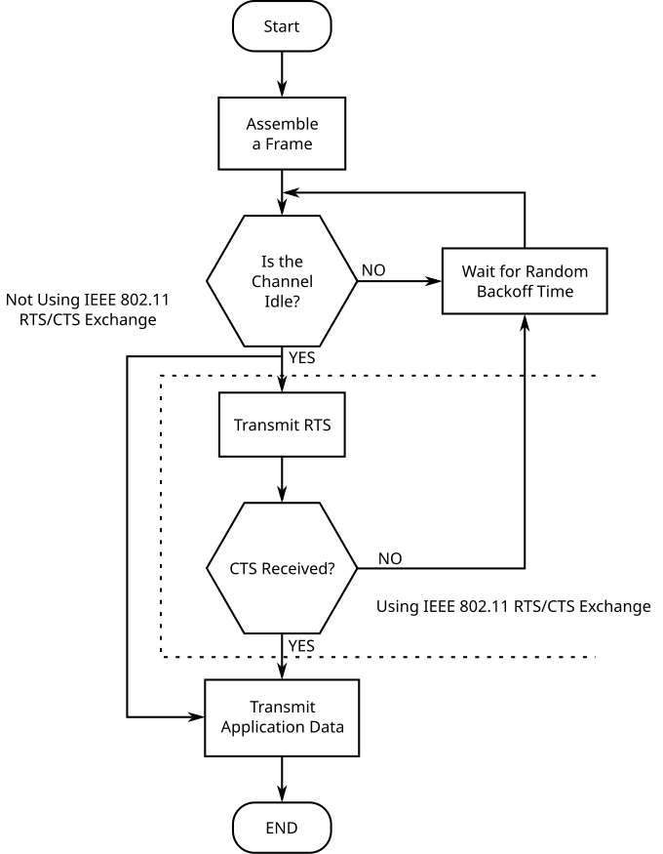
CSMA/CA
Carrier Sense Multiple Access / Collision Avoidance
Is the channel busy?
May I please send? (RTS)
You are allowed to send (CTS)

Slide 9
Multiplexing
One long signal in, multiple short signals out
Literally dividing transmission time by the number of distinct output signals

Slide 10
FDM
Frequency Division Multiplexing
Channel 1
Channel 2
Channel 3
Total Band

Slide 11
OFDM
Orthogonal Frequency Division Multiplexing
Channel 2
Channel 4
Some overlapping is okay because of MATHS
Channel 1
Channel 3
Channel 5
Total Band

Slide 12
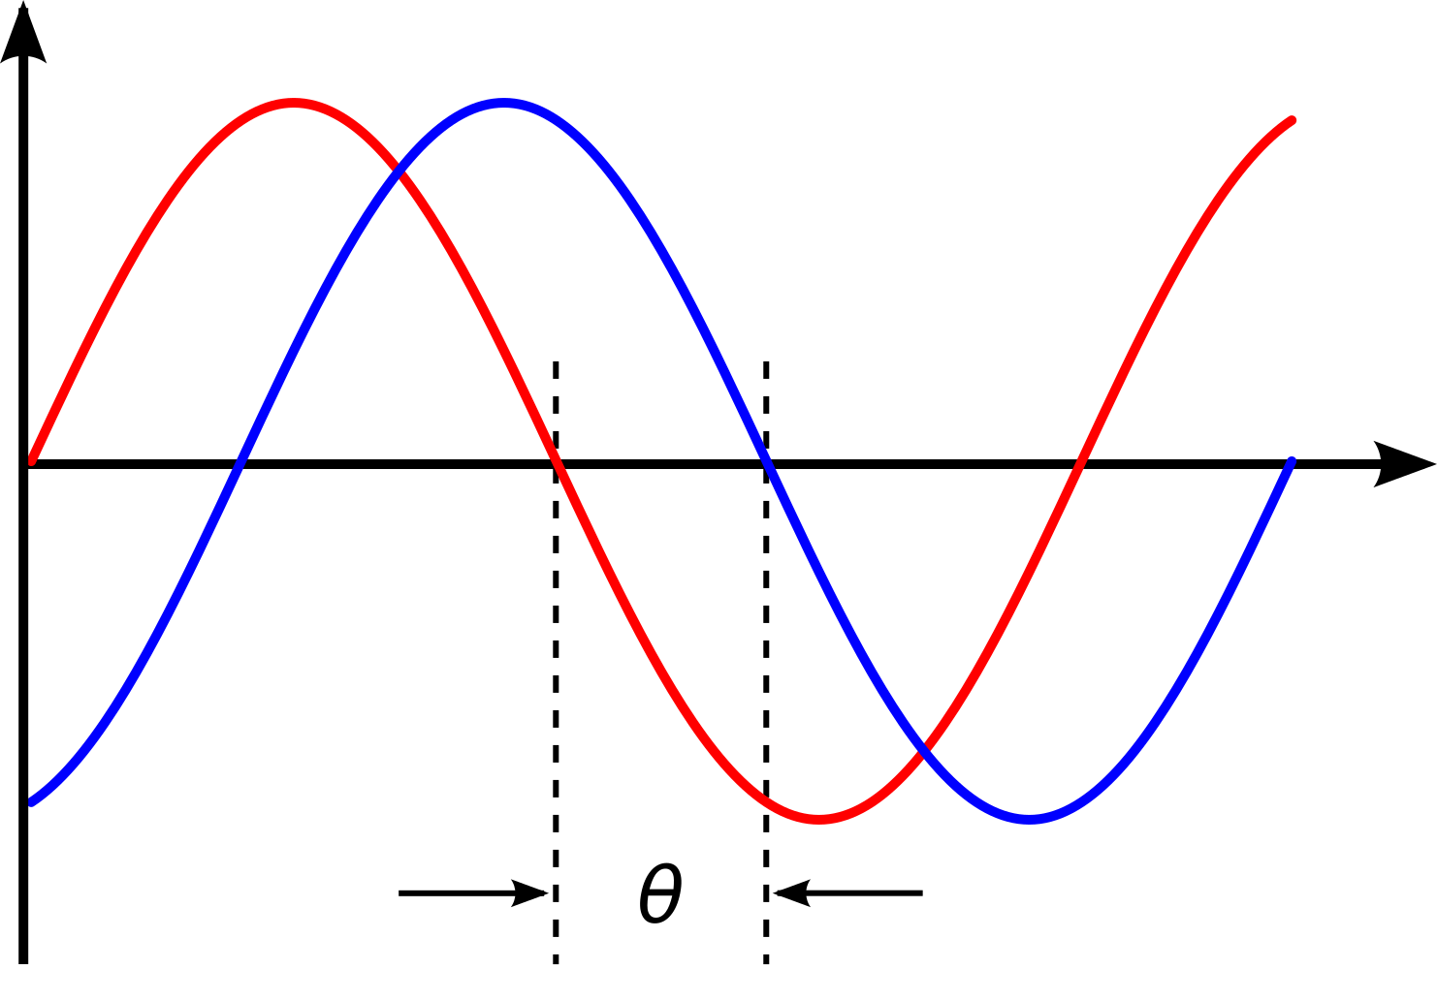
Multipath Propagation
The same signal may arrive multiple times and at different times

Slide 13
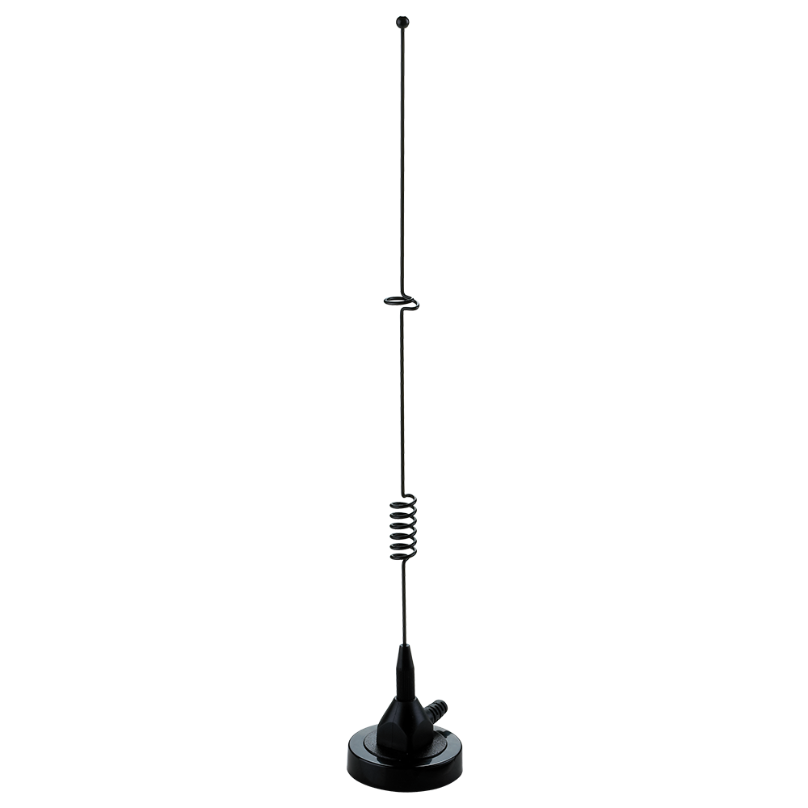
MIMO
Multiple Input Multiple Output

Slide 14
Generational Differences
Frequency bands (900 MHz, 2.4 GHz, 5 GHz, 6 GHz)
Modulation techniques
Channel widths (20 - 80 MHz)

Slide 15
Frames
What are we sending anyway?

Slide 16
Frame Size
16
16
48
48
48
0
or
16
48
0
or
16
0
or
32
0
to
18496
32
Bits

Slide 17
Frame Control Field
2
2
4
1
1
1
1
1
1
1
1
00 unless 802.11ah/Wifi HaLow

Slide 18
Frame Control Field
2
2
4
1
1
1
1
1
1
1
1
00 for management frame
01 for control frame
10 for data frame
11 for extension frame

Slide 19
Subtypes of Management Frames
2
2
4
1
1
1
1
1
1
1
1
0000 association request
0001 association response
0010 reassociation request
0011 reassociation response
0100 probe request
0101 probe response
0110 timing advertisement
0111 reserved
1000 beacon
1001 ATIM
1010 disassociation
1011 authentication

Slide 20
Subtypes of Management Frames Continued
2
2
4
1
1
1
1
1
1
1
1
1100 deauthentication
1101 action
1110 action no ack
1111 reserved

Slide 21
Subtypes of Frame Types
2
2
4
1
1
1
1
1
1
1
1
Other frame type subtypes see:
https://en.wikipedia.org/wiki/802.11_frame_types#Types_and_subtypes

Slide 22
To and From DS
2
2
4
1
1
1
1
1
1
1
1
Denotes if a frame is to or from a distributed system
This is how you can have multiple access points serving the same network

Slide 23
More Fragments
2
2
4
1
1
1
1
1
1
1
1
Denotes that a frame is only part of a larger transmission and there are ‘more fragments’ on the way

Slide 24
Retry
2
2
4
1
1
1
1
1
1
1
1
This is a retransmission of an earlier frame

Slide 25
Power Management
2
2
4
1
1
1
1
1
1
1
1
Please hold, I’m going to nap
&
Okies, I’m awake, send the datas

Slide 26
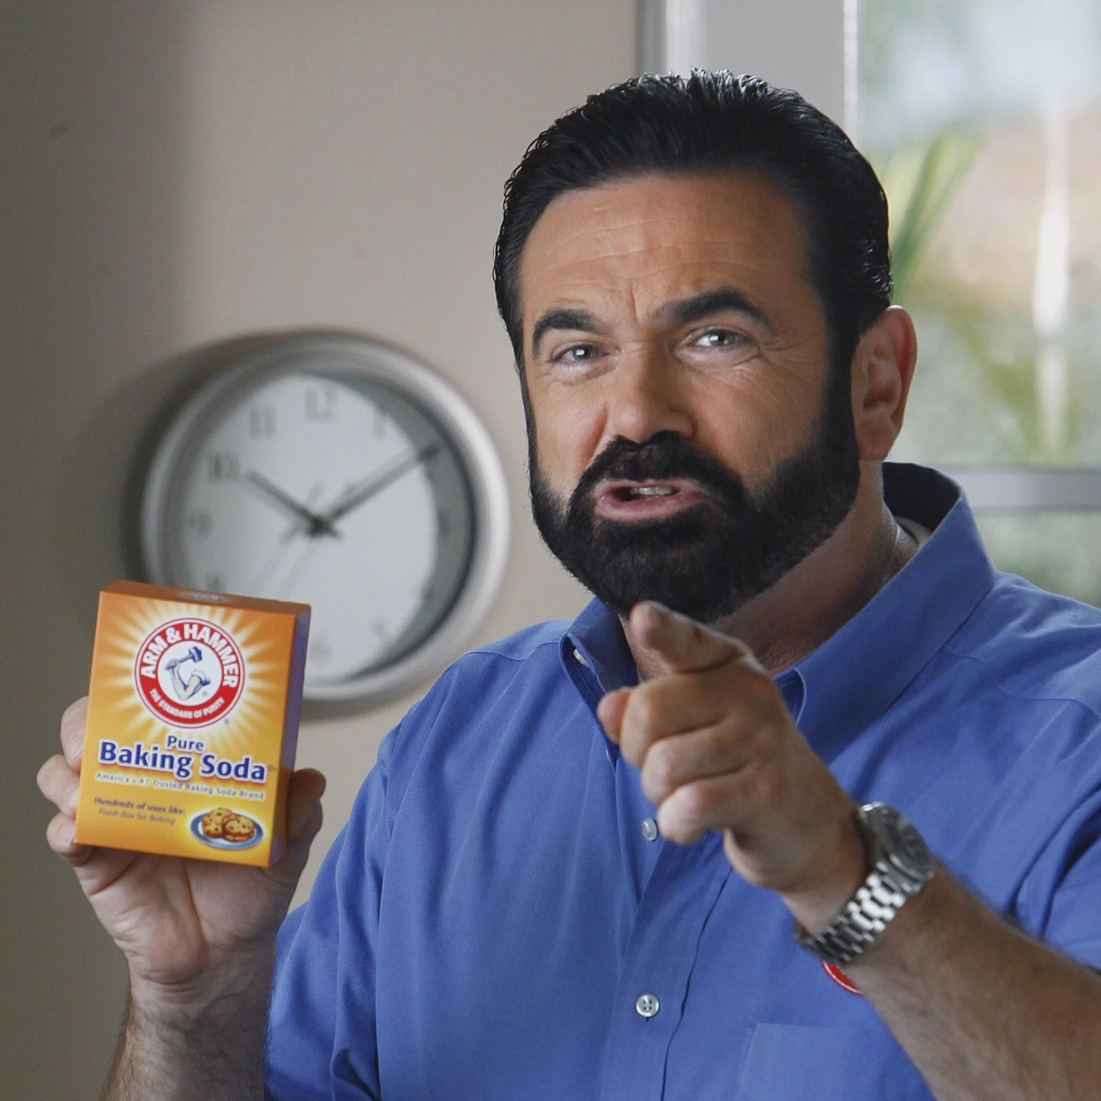
More Data
2
2
4
1
1
1
1
1
1
1
1
But wait, there’s more!

Slide 27
Protected Frame
2
2
4
1
1
1
1
1
1
1
1
Is this a protected frame?

Slide 28
Protected Frames
We can encrypt frames now???
YES! Optional for WPA2 and required for WPA3… except for…
Beacons
Probes
Authentication
Association
ATIM
Channel Switch Announcement as Broadcast

Slide 29
High Throughput Control / Order
2
2
4
1
1
1
1
1
1
1
1
Indicates QoS or a high throughput control field

Slide 30
Frame Addresses
To an Access Point
Address 1: BSSID
Address 2: Source
Address 3: Destination
Address 4: Not used

Slide 31
Frame Addresses
From an Access point
Address 1: Destination
Address 2: BSSID
Address 3: Source
Address 4: Not used
Sniffing enabled BY DESIGN

Slide 32
Frame Check Sequence
32 bit Cyclic Redundancy Check

Slide 33
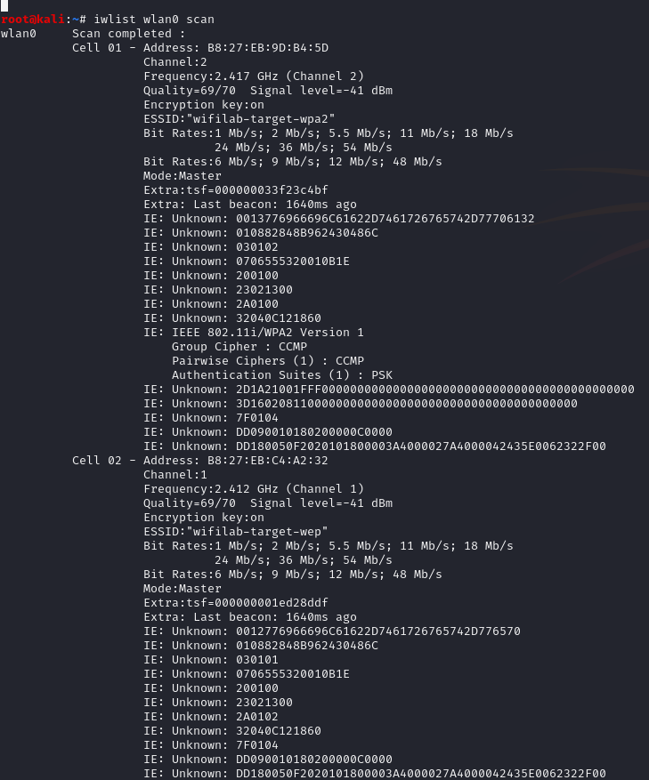
Look at our surroundings

Slide 34
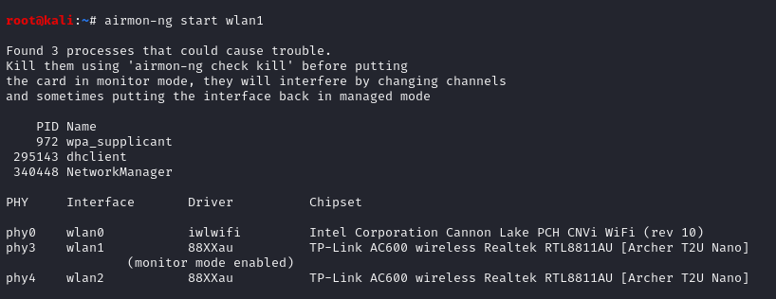
Let’s Listen
airodump-ng wlan1 -w lab —essid=wifilab-target-wep

Slide 35
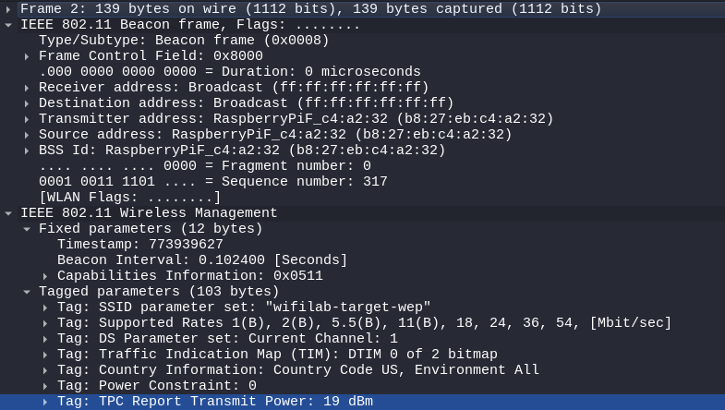
First Frame
Information we have
Addresses
OUIs
SSID

Slide 36
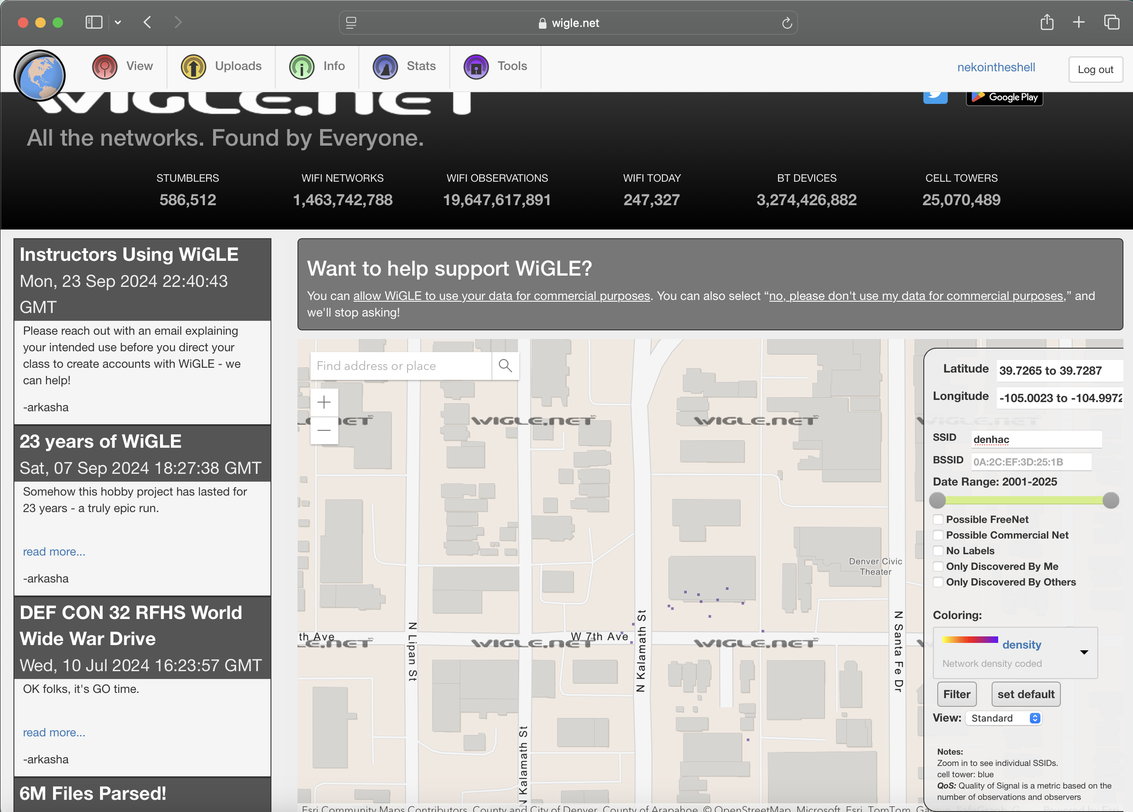
WiGLE!
Real creeper hours

Slide 37
Hidden Wifi Networks
Hidden text
Broadcast null byte for each character in ESSID.
Broadcast “” as ESSID
… Just wait for a probe from a client or an association

Slide 38
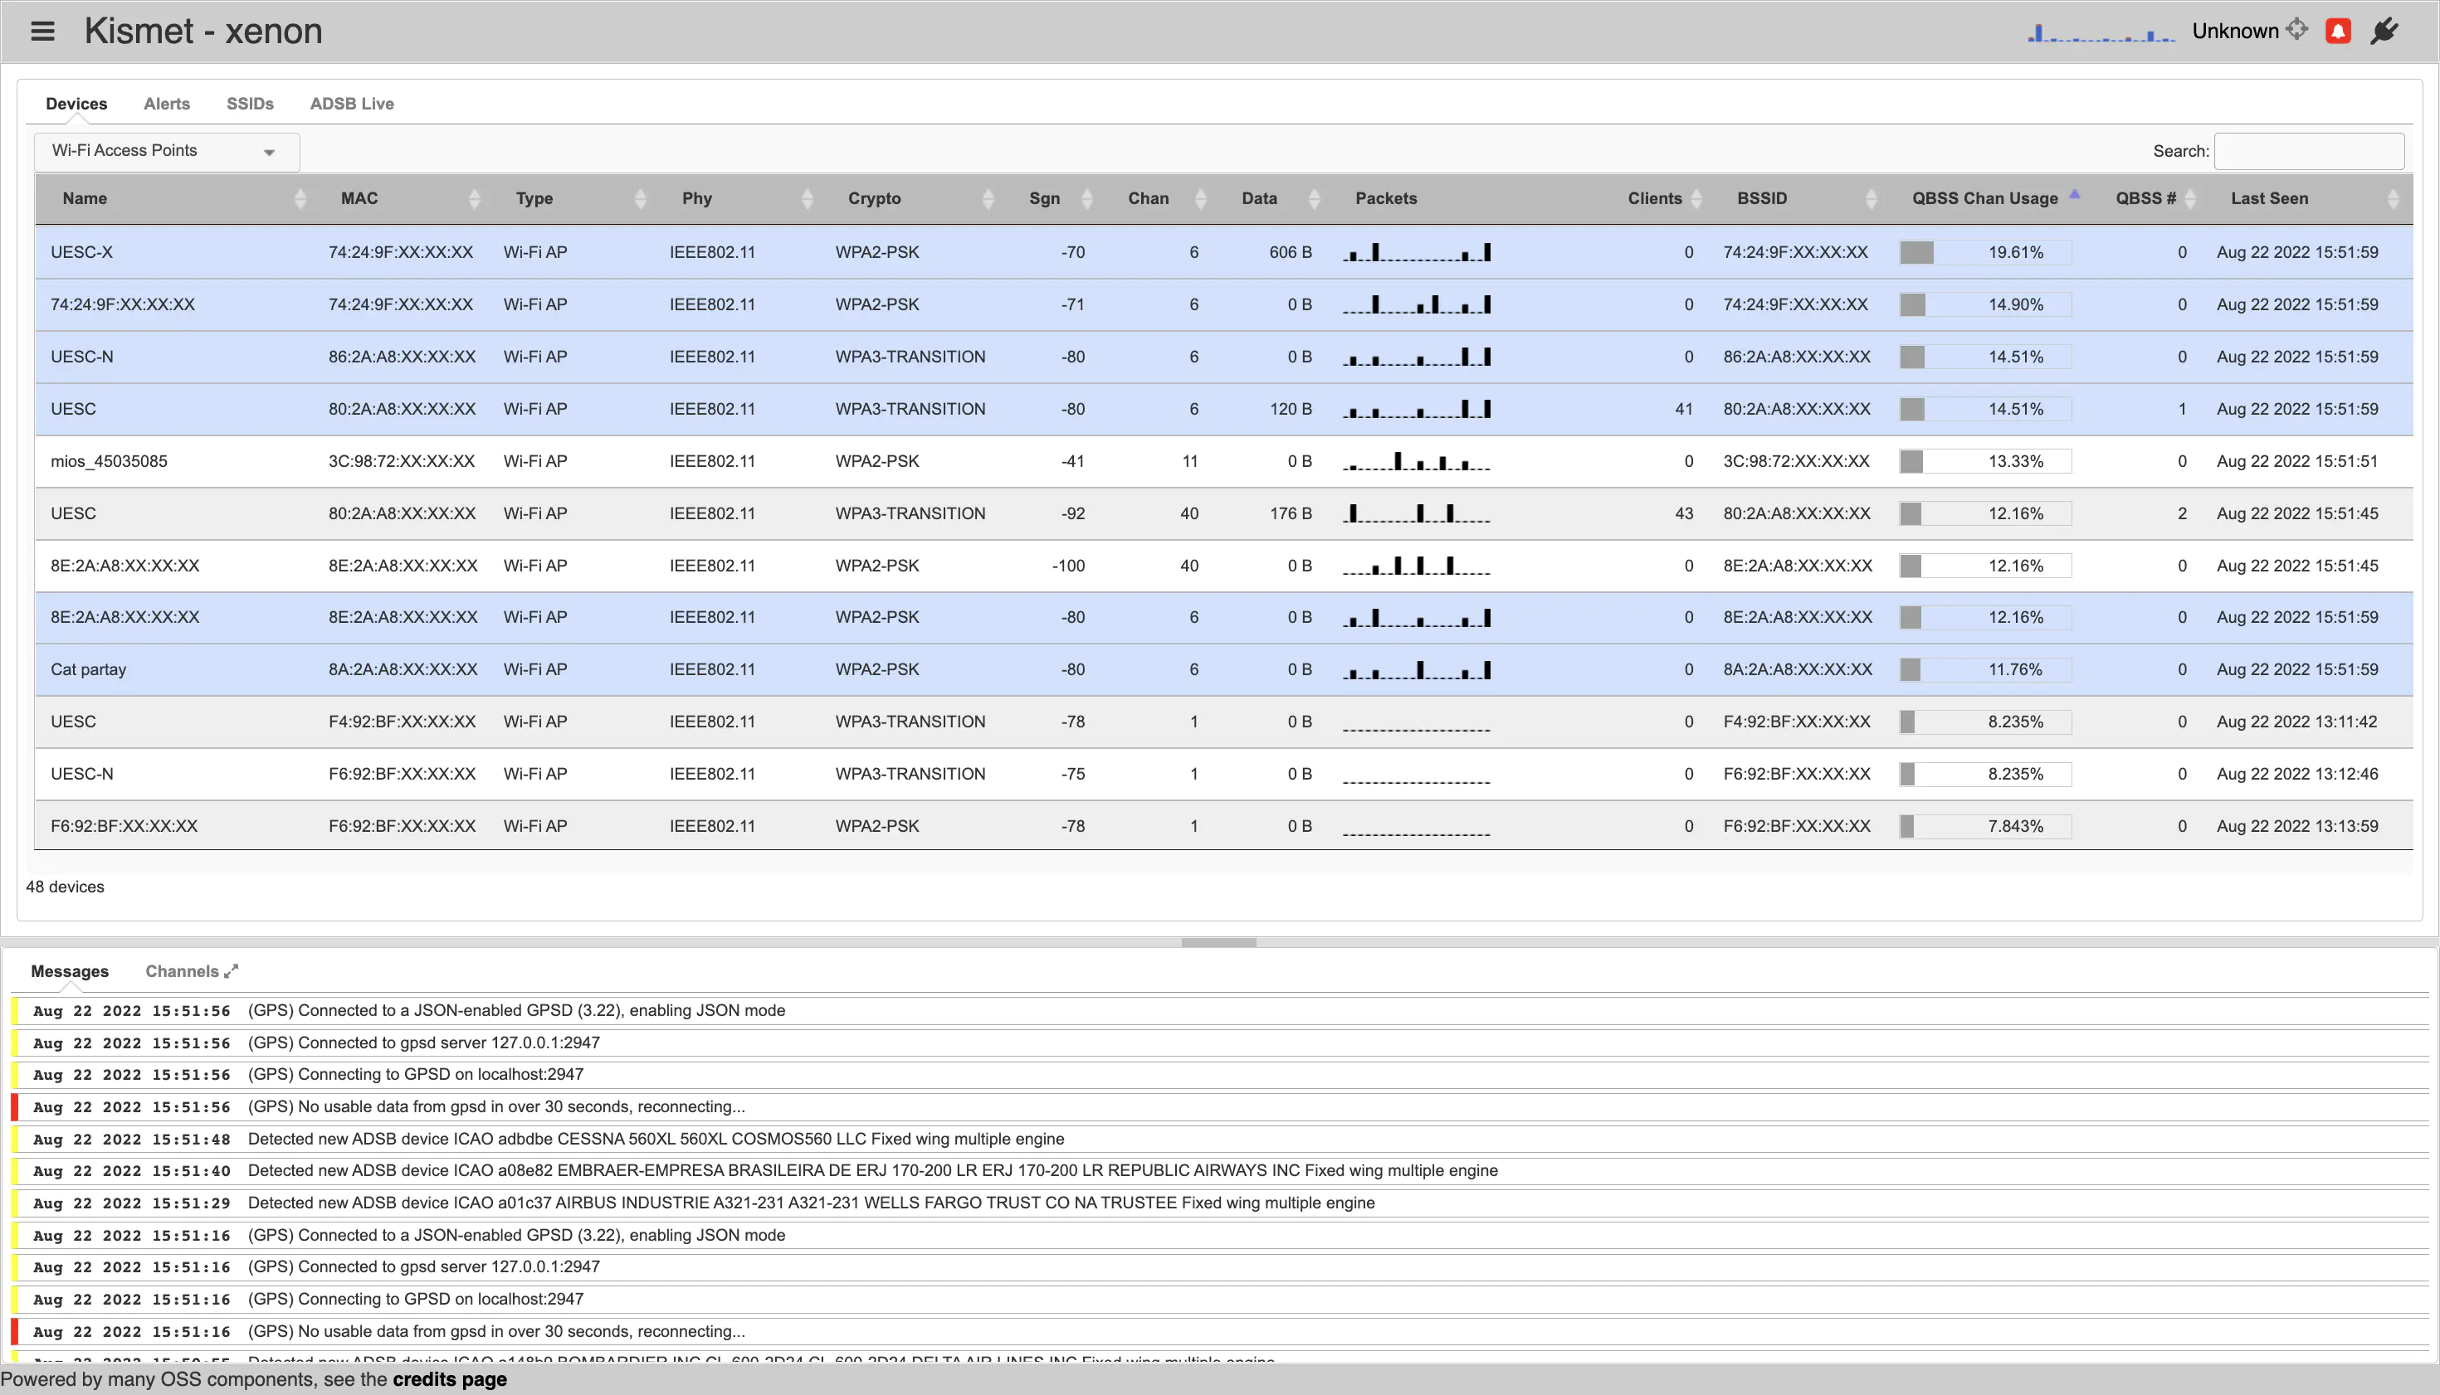
Kismet

Slide 39
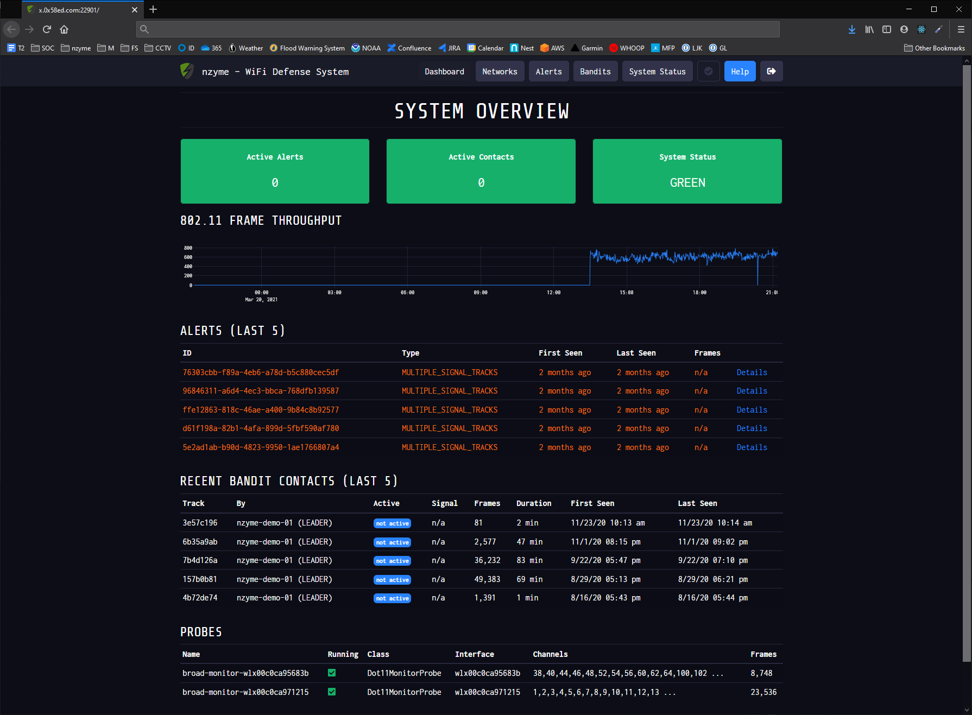
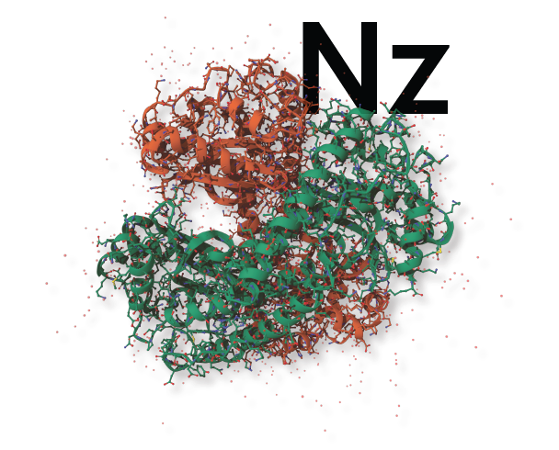
Nzyme
Defender’s Kismet

Slide 40
WEP Handshakes
May I please authenticate?
I CHALLENGE YOU!
*screams gibberish*
*encrypts the gibberish*
Oh, you got hands.
Nevermind, you can auth

Slide 41
RC4 cola
Initialization vectors: 24 bits
WEP 40: 40 bit key + 24 bit IV = 64 bit key
WEP 104: 104 bit key + 24 bit IV = 128 bit key
IVs are transmitted in plaintext, you already know some of the key!

Slide 42
WEP Cracking
Not enough traffic?
Try a replay attack with aireplay-ng —caffe-latte
Made possible by CRC

Slide 43
Enter WPA
TKIP (Temporal Key Integrity Protocol)
Dynamic 128-bit keys
Still RC4 stream cipher
Sequence counter to counter replay attacks
MIC (Message Integrity Check)

Slide 44
If WPA was so good, why isn’t there a WPA2?
CCMP (makes use of AES (which is a variant of Rijndael))
New Handshakes
Another 128-bit key
EAP and MSCHAPv2 vulns beyond scope
Aircrack dictionary attacks still work, so we have that going for us

Slide 45
WPA2 Handshake
Here, have a random number (nonce)
Aww, thanks.
Here’s a random number for you too
*decides pairwise transient key*
Have some random data, on the house
Sweet, I can decrypt that and it’s a love note <3

Slide 46
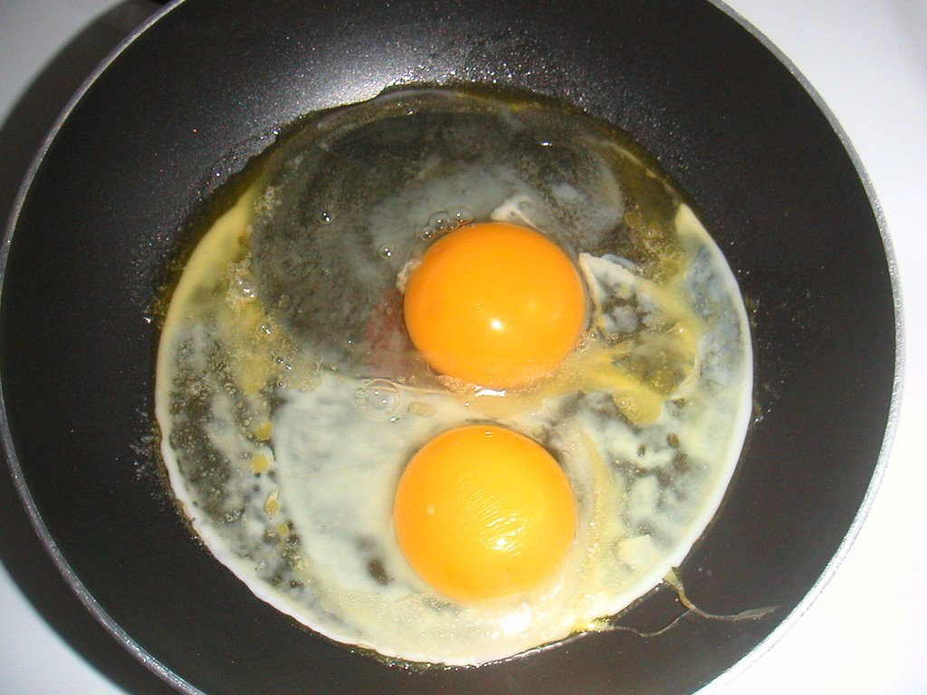
KRACK
Key Reinstallation Attack, just say no
Pretend to be the AP
Replay part 3 of the 4-way handshake
Reset incremental transmit packet & replay counter
…
Profit

Slide 47
HOLE
Hole196
All clients have the same GTK (Group Transient Key)
So all clients can broadcast with that key
And pretend to be any other client, or the AP

Slide 48
Well if WPA2 was so…
WPA3
TKIP was last years news
CCMP-128, still cool
GCMP? (AES-256 with SHA-384 for HMAC)
No more PSK (except with EAP), only SAE
KRACK still useful due to WPA2 - WPA3 transitional settings

Slide 49
What is SAE?
Dragonfly / RFC7664
Uses “domain parameters” (PSK & MAC address)
Elliptic Curve Cryptography & Finite Field Cryptography
Forward Secrecy

Slide 50
Frag Attacks
Frame Aggregation
Frame Fragmentation
Mixed key attack (or even no key)
Fragment cache attack
Some devices accept unencrypted frames… for the lolz
This is the bleeding edge and where my knowledge ends
Read https://www.fragattacks.com/

Slide 51
Unless? WPS
EAP (Extensible Authentication Protocol)
8 digit pins

Slide 52
Evil Twins
ESSIDs are changeable by nature
BSSIDs can be spoofed easily
‘ip link set dev wlan0 address c0:01:de:ad:be:ef’
Can’t trick the computer? Try the user.

Slide 53
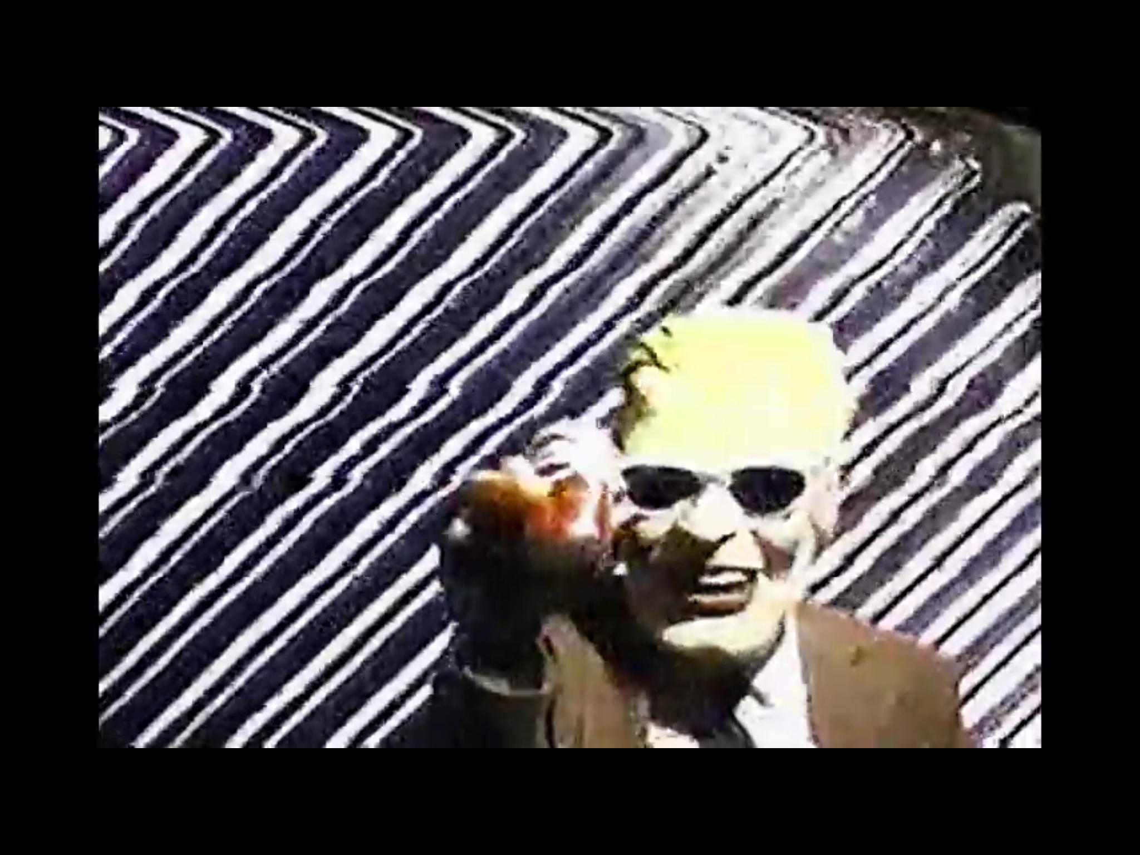
Risks?
Get creative
Lots of sites load images over HTTP
XSS through JS in SVGs?
Insert shock image du jour?
You never know what’s plaintext
Thank you!

